Slide 1

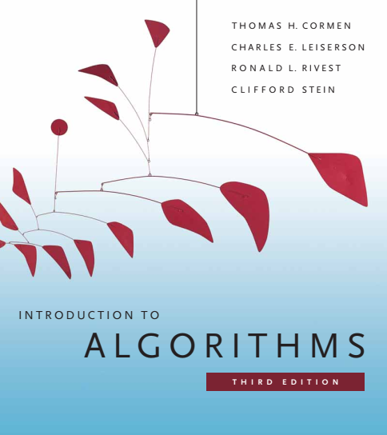
Design and Analysis of Algorithms
Dr. Sajid Iqbal
sajidiqbal.pk@gmail.com
Reference Book
Introduction to Algorithms 3rd Edition By Thomas H. Cormen et. al.
https://mitpress.mit.edu/books/introduction-algorithms-third-edition
COMEDXD

Slide 2
Order Statistics
Worst case running time

Slide 3
Introduction
SELECT: A selection algorithm whose running time is O(n) in the worst case.
This algorithm finds ith order statistic by recursively partitioning the input array.
SELECT guarantees that a good split will be produced upon partitioning the array.
SELECT uses the deterministic partitioning algorithm PARTITION from quicksort and modifies it and takes pivot element as an input too

Slide 4

The SELECT Algorithm
Step 1: Divide n-input elements into ⌊n/5⌋ groups of 5 elements each
At most one group can contain n % 5 elements (less than 5 elements)
The number of groups formed are ⌈n/5⌉
Step 2:
sort the elements of each group using insertion sort.
Find median of each group
Step 3:
Find median $x$ of medians of all groups
Step 4:
Partition the input array around $x$ using modified version of partition. Let $x$ is the $kth$ smallest element of the array such that $A\left[p,…,q−1\right]≤x=A[q]<A[q+1,…,r]$
The partition of elements is as follows $[q−p+1][q][n−k]$ and k=q
Step 5:
If $i=k$, then return$x$
If $i<k$, search recursively in lower sub-array
If $i>k$, search recursively in upper sub-array

Slide 5
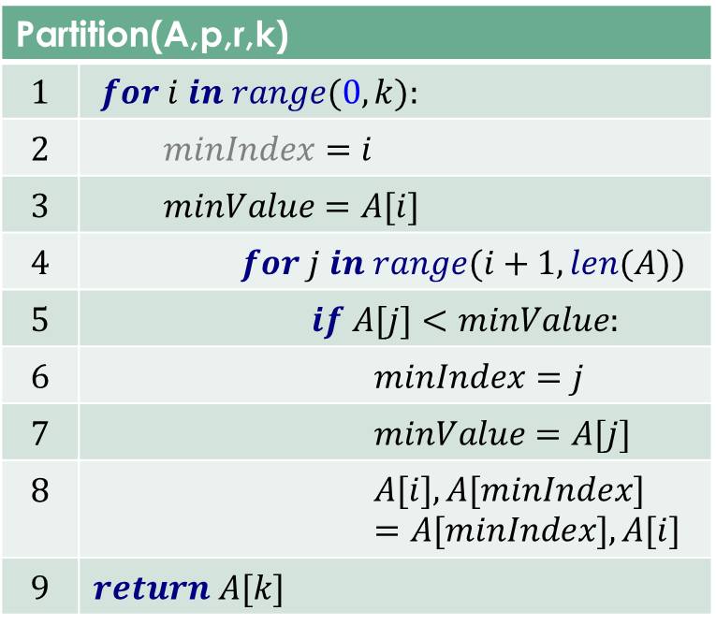
Modified Partition
This algorithm returns the kth smallest element A[k]
The algorithm also re-arranges the array
Example: For an Array
A = [2, 8, 7, 1, 3, 5, 6, 4]
[1, 2, 8, 7, 3, 5, 6, 4] after Partition(A,p,r,2)
[1, 2, 3, 4, 8, 7, 6, 5] after Partition(A,p,r,4)
[1, 2, 3, 4, 5, 8, 7, 6] after Partition(A,p,r,5)
[1, 2, 3, 4, 5, 6, 7, 8] after Partition(A,p,r,7)
Partition(A,p,r,k)
$$1$$ | $$for i in range(0,k):$$
$$2$$ | $$minIndex=i$$
$$3$$ | $$minValue=A[i]$$
$$4$$ | $$for j in range(i+1,len(A))$$
$$5$$ | $$if A[j]<minValue:$$
$$6$$ | $$minIndex=j$$
$$7$$ | $$minValue=A[j]$$
$$8$$ | $$A[i],A[minIndex]=A[minIndex],A[i]$$
$$9$$ | $$return A[k]$$

Slide 6
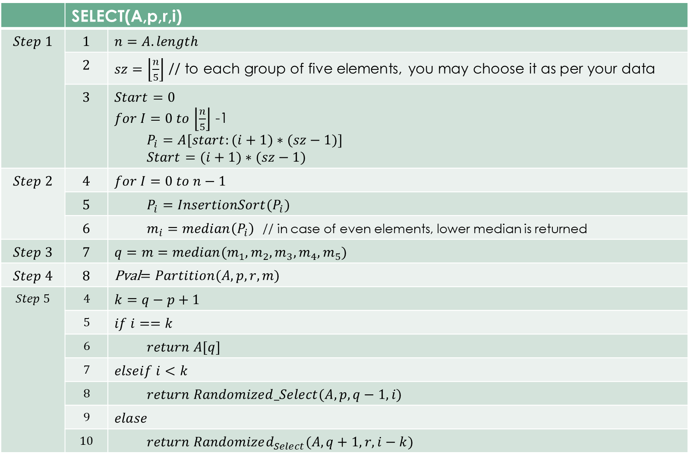
SELECT Algorithm
 | SELECT(A,p,r,i)
$$Step 1$$ | $$1$$ | $$n=A.length$$
 | $$2$$ | $sz=\left\lfloor \frac{n}{5}\right\rfloor$ // to each group of five elements, you may choose it as per your data
 | $$3$$ | $$Start=0$$ $for I=0 to$ $\left\lfloor \frac{n}{5}\right\rfloor$ -1 $$P_{i}=A[start:(i+1)∗(sz−1)]$$ $$Start=(i+1)∗(sz−1)$$
$$Step 2$$ | $$4$$ | $$for I=0 to n−1$$
 | $$5$$ | $$P_{i}=InsertionSort(P_{i})$$
 | $$6$$ | $m_{i}=median\left(P_{i}\right)$ // in case of even elements, lower median is returned
$$Step 3$$ | $$7$$ | $$q=m=median(m_{1},m_{2},m_{3},m_{4},m_{5})$$
$$Step 4$$ | $$8$$ | Pval$=Partition(A,p,r,m)$
$$Step 5$$ | $$4$$ | $$k=q−p+1$$
 | $$5$$ | $$if i==k$$
 | $$6$$ | $$return A[q]$$
 | $$7$$ | $$elseif i<k$$
 | $$8$$ | $$return Randomized_Select(A,p,q−1,i)$$
 | $$9$$ | $$elase$$
 | $$10$$ | $$return Randomized_{Select}(A,q+1,r,i−k)$$

Slide 7
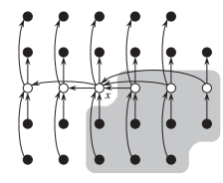

Time Complexity Analysis
Find the lower bound on the number of elements that are less than pivot element
n-elements are represented by circles
Each group of elements forms a column with white circle as median
Median of medians is labeled as $x$
Arrows go from larger elements to smaller elements
We can see that
$3$ out of each group on left of $x$ are less than $x$
$3$ out of each group on right of $x$ are greater than $x$
Elements greater than $x$ in each group are shaded
The conditions may vary for last group and group containing $x$.

Slide 8

Worse case analysis
At least half ($\frac{1}{2}$) of the medians found in step $2$ are greater than or equal to the median-of-medians $x$
At least half of the $\left\lceil \frac{n}{5}\right\rceil$ groups contribute at least $3$ elements that are greater than $x,$
Except for the group that has fewer than $5$ elements if 5 does not divide n exactly and
The one group containing $x$ itself
The number of elements greater than $x$ are at least
Half of the all groups minus two contribute $3$ elements
$3\left(\frac{1}{2}\left\lceil \frac{n}{5}\right\rceil −2\right)≥3\left(\frac{1}{2}\frac{n}{5}−2\right)=\frac{3n}{10}−6$
Similarly at least $\frac{3n}{10}−6$ elements are less than $x$
In worst case, we need to search either sub-array and leave $\frac{3n}{10}−6$ elements
So items to be searched are $n−\left(\frac{3n}{10}−6\right)=\frac{7n}{10}+6$
In worst case step-5 is called $\frac{7n}{10}+6$ times

Slide 9
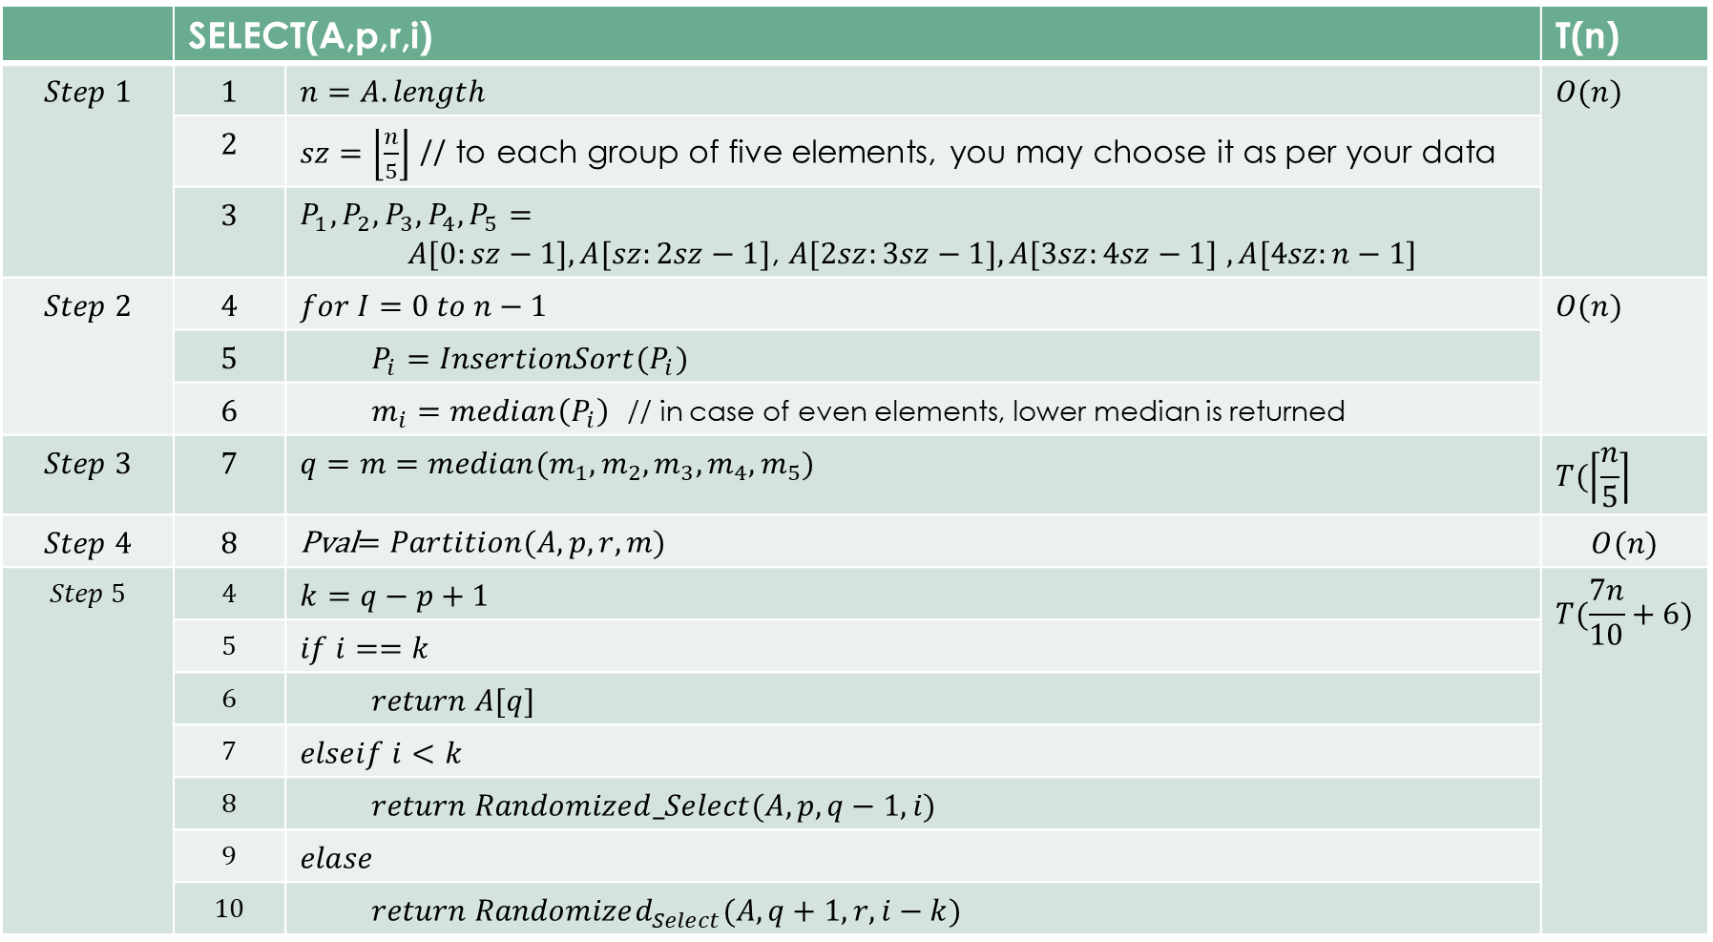
 | SELECT(A,p,r,i) |  | T(n)
$$Step 1$$ | $$1$$ | $$n=A.length$$ | $$O(n)$$
 | $$2$$ | $sz=\left\lfloor \frac{n}{5}\right\rfloor$ // to each group of five elements, you may choose it as per your data
 | $$3$$ | $$P_{1},P_{2},P_{3},P_{4},P_{5}=$$ $A[0:sz−1],A[sz:2sz−1]$, $A[2sz:3sz−1],A[3sz:4sz−1]$ $,A[4sz:n−1]$
$$Step 2$$ | $$4$$ | $$for I=0 to n−1$$ | $$O(n)$$
 | $$5$$ | $$P_{i}=InsertionSort(P_{i})$$
 | $$6$$ | $m_{i}=median\left(P_{i}\right)$ // in case of even elements, lower median is returned
$$Step 3$$ | $$7$$ | $$q=m=median(m_{1},m_{2},m_{3},m_{4},m_{5})$$ | $$T(\left\lceil \frac{n}{5}\right\rceil$$
$$Step 4$$ | $$8$$ | Pval$=Partition(A,p,r,m)$ | $$O(n)$$
$$Step 5$$ | $$4$$ | $$k=q−p+1$$ | $$T(\frac{7n}{10}+6)$$
 | $$5$$ | $$if i==k$$
 | $$6$$ | $$return A[q]$$
 | $$7$$ | $$elseif i<k$$
 | $$8$$ | $$return Randomized_Select(A,p,q−1,i)$$
 | $$9$$ | $$elase$$
 | $$10$$ | $$return Randomized_{Select}(A,q+1,r,i−k)$$

Slide 10
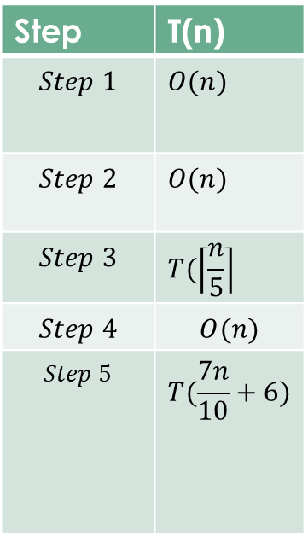

Time Complexity
$T\left(n\right)=O\left(n\right)+O\left(n\right)+T\left(\left\lceil \frac{n}{5}\right\rceil \right)+O\left(n\right)+T(\frac{7n}{10}+6)$
$T\left(n\right)=T(\frac{7n}{10}+6)$+$T\left(\left\lceil \frac{n}{5}\right\rceil \right)$+$3O\left(n\right)$
$T\left(n\right)=T(\frac{7n}{10}+6)$+$T\left(\left\lceil \frac{n}{5}\right\rceil \right)$+$O\left(n\right)$
$T\left(n\right)≤c(\frac{7n}{10}+6)$+$c\left(\left\lceil \frac{n}{5}\right\rceil \right)$+$a\left(n\right)$
$T\left(n\right)≤(\frac{7cn}{10}+6c)$+($\frac{cn}{5}+c$)+$an$
$T\left(n\right)≤\frac{7cn}{10}+6c$+$\frac{cn}{5}+c$+$an$
$T\left(n\right)≤\frac{7cn}{10}+7c$+$\frac{cn}{5}$+$an$=$\frac{9cn}{10}+7c+an$
$\left(cn−\frac{cn}{10}\right)+7c+an=$ $cn−\left(\frac{cn}{10}−7c−an\right)=O(n)$
Step | T(n)
$$Step 1$$ | $$O(n)$$
$$Step 2$$ | $$O(n)$$
$$Step 3$$ | $$T(\left\lceil \frac{n}{5}\right\rceil$$
$$Step 4$$ | $$O(n)$$
$$Step 5$$ | $$T(\frac{7n}{10}+6)$$
Hence, worst case is also linear

Slide 11

Thanks for watching
Dr. Sajid Iqbal
Assistant Professor
Department of Computer Science
Bahauddin Zakariya University, Multan
sajidiqbal.pk@gmail.com
Slides: https://github.com/sajjo79/Design_and_Analysis_of_Algorithms
YouTube Channel: COMEDXD
Allah Hafiz

Slide 12
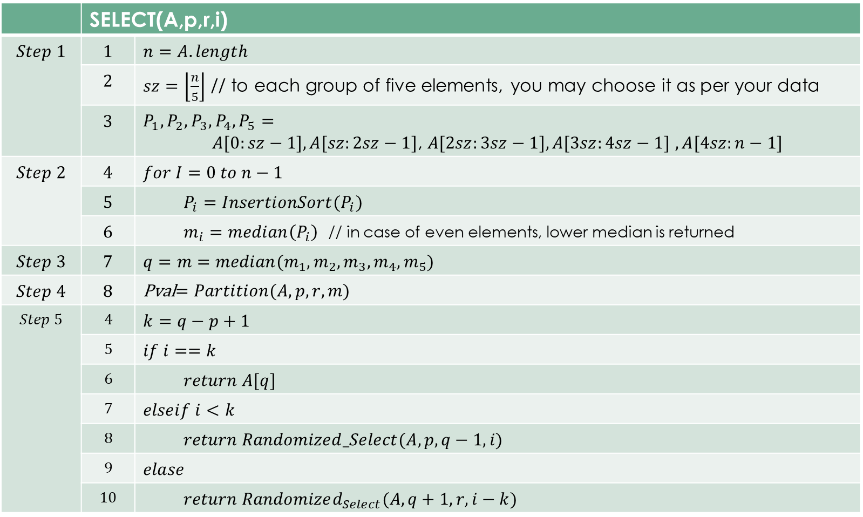
 | SELECT(A,p,r,i)
$$Step 1$$ | $$1$$ | $$n=A.length$$
 | $$2$$ | $sz=\left\lfloor \frac{n}{5}\right\rfloor$ // to each group of five elements, you may choose it as per your data
 | $$3$$ | $$P_{1},P_{2},P_{3},P_{4},P_{5}=$$ $A[0:sz−1],A[sz:2sz−1]$, $A[2sz:3sz−1],A[3sz:4sz−1]$ $,A[4sz:n−1]$
$$Step 2$$ | $$4$$ | $$for I=0 to n−1$$
 | $$5$$ | $$P_{i}=InsertionSort(P_{i})$$
 | $$6$$ | $m_{i}=median\left(P_{i}\right)$ // in case of even elements, lower median is returned
$$Step 3$$ | $$7$$ | $$q=m=median(m_{1},m_{2},m_{3},m_{4},m_{5})$$
$$Step 4$$ | $$8$$ | Pval$=Partition(A,p,r,m)$
$$Step 5$$ | $$4$$ | $$k=q−p+1$$
 | $$5$$ | $$if i==k$$
 | $$6$$ | $$return A[q]$$
 | $$7$$ | $$elseif i<k$$
 | $$8$$ | $$return Randomized_Select(A,p,q−1,i)$$
 | $$9$$ | $$elase$$
 | $$10$$ | $$return Randomized_{Select}(A,q+1,r,i−k)$$

